Slide 1
Introduction to Minecraft: Pi Edition
(mcpi API)

Slide 2
Hello, World!
In the Minecraft chat

Slide 3
Getting Started
Open IDLE
File > Open
Minecraft-Scripts -> my-scripts -> helloworld.py

Slide 4
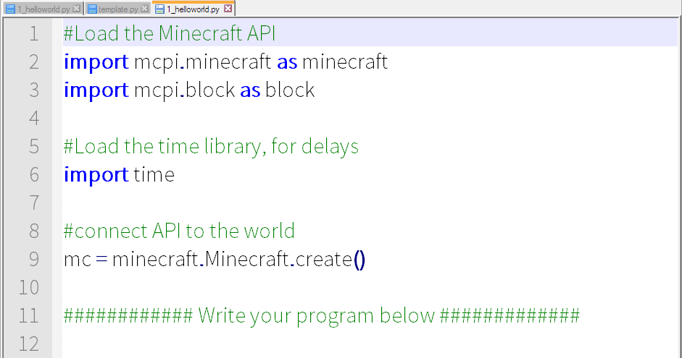
Don’t Panic

Slide 5
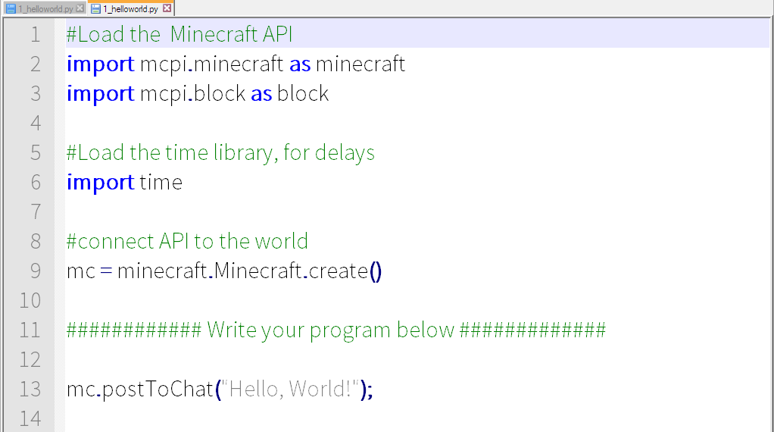
Hello, World!

Slide 6
Running “Hello, World!”
Make sure Minecraft is running (in-world)
Save your file (File -> Save)
Run the Program (Run->Run Module OR Press F5)

Slide 7
Midas Touch
Changing a block

Slide 8
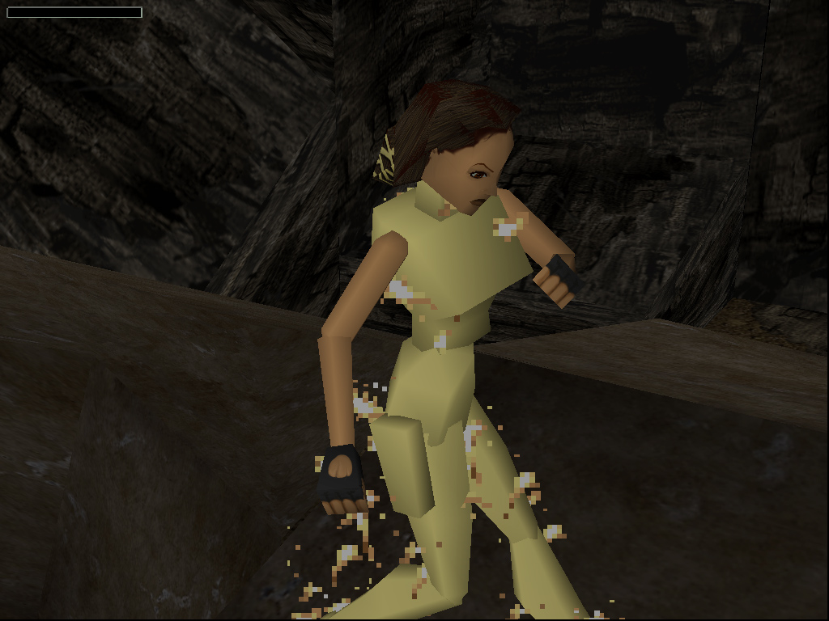
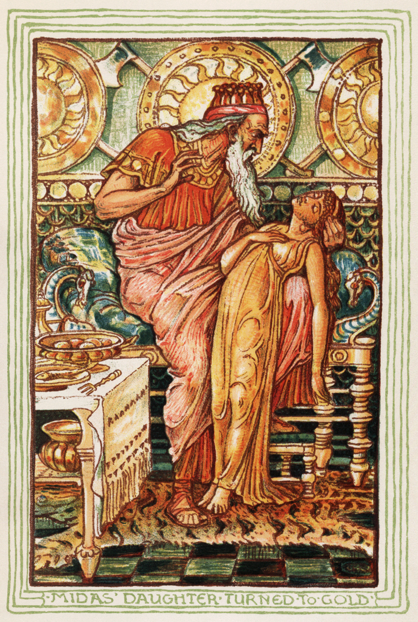
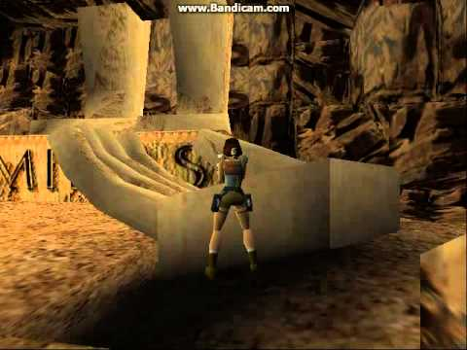
Midas Touch
In Greek mythology, King Midas turned everything he touched into gold
Let’s do the same thing in Minecraft

Slide 9
What do we want to do?

Slide 10
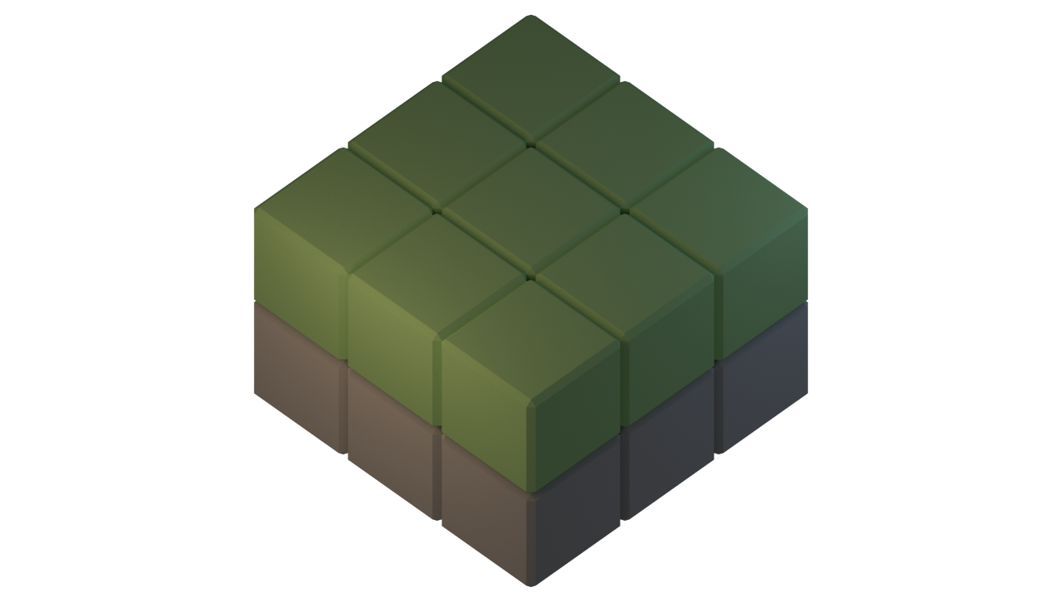

Slide 12


Slide 13


Slide 14
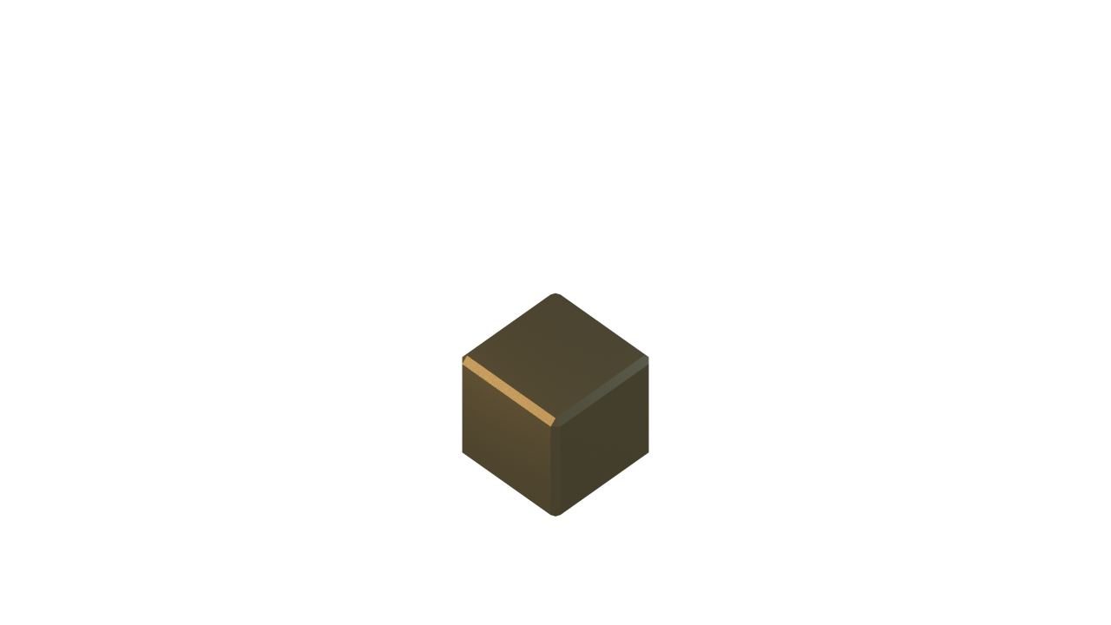

Slide 15
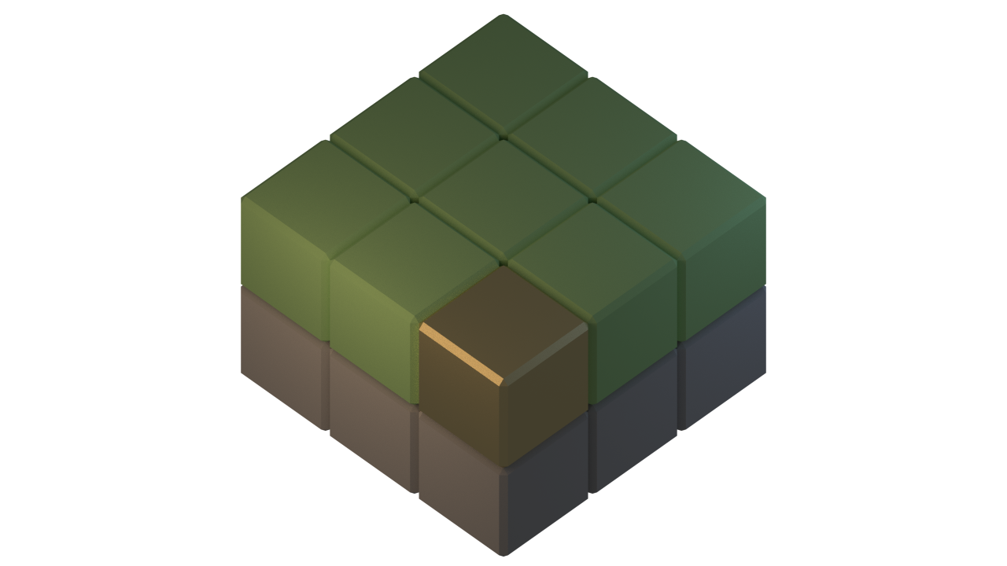

Slide 16
Creating a new file
Open File Browser
Go to Minecraft-Scripts Folder
Copy template.py
Paste in my-scripts and rename (e.g. 1_midastouch.py)
Open the file in IDLE

Slide 17
Running the program
Make sure Minecraft is running (in-world)
Save your file (File -> Save)
Run the Program (Run->Run Module OR Press F5)

Slide 18
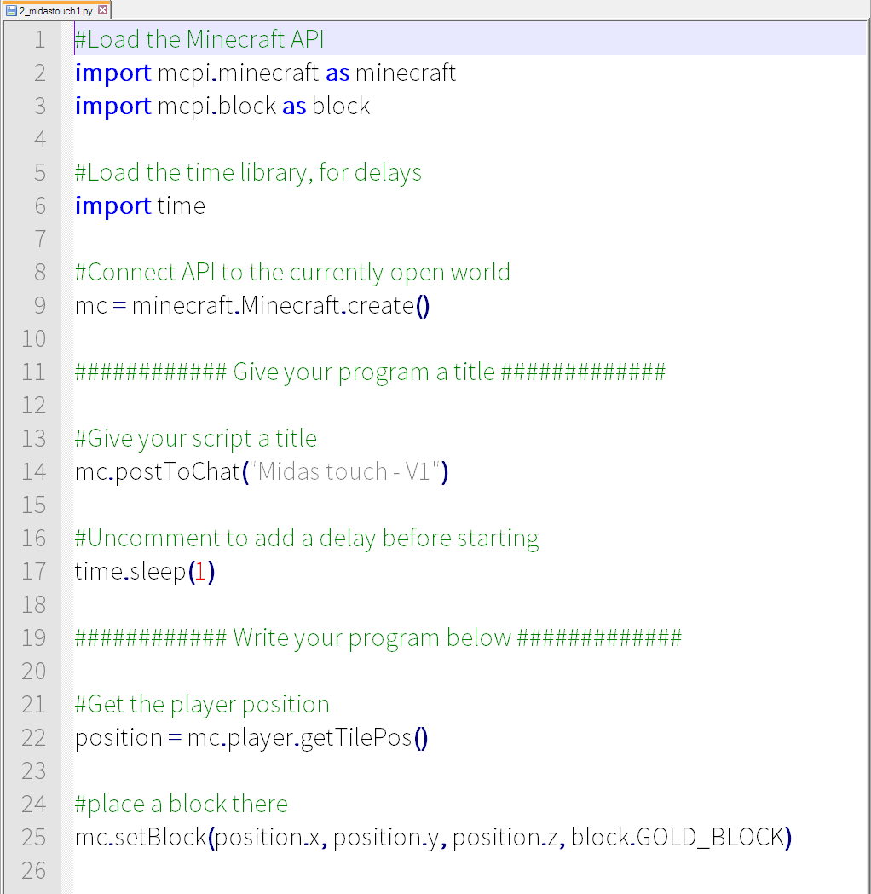
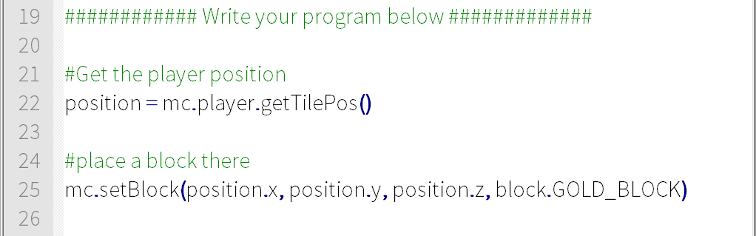
Midas Touch

Slide 20
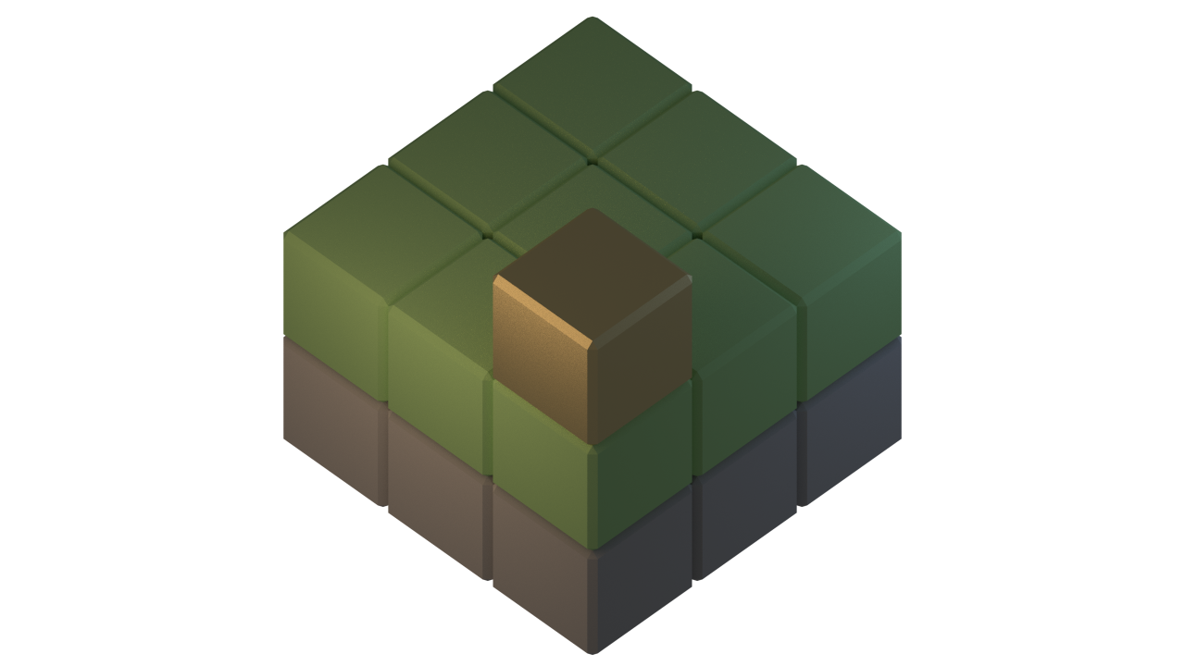

Slide 21
(x, y, z)
Y
X
Z

Slide 22
(0, 2, 0)
Y
X
Z

Slide 23
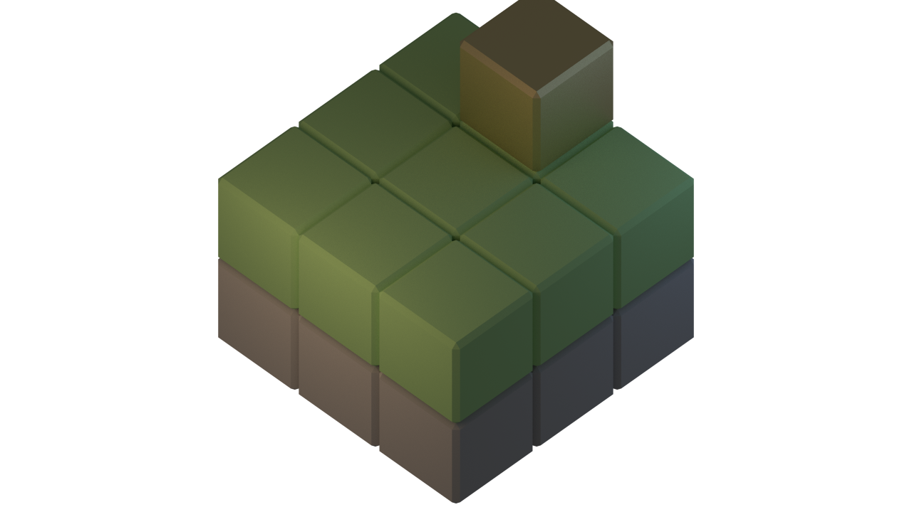
(1, 2, 2)
Y
X
Z

Slide 24
(0, 1, 0)
Y
X
Z

Slide 25
(0, 2, 0)
Y
X
Z

Slide 26
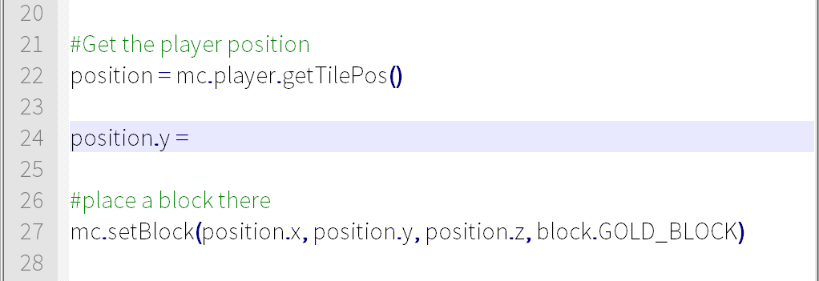
Midas Touch

Slide 27
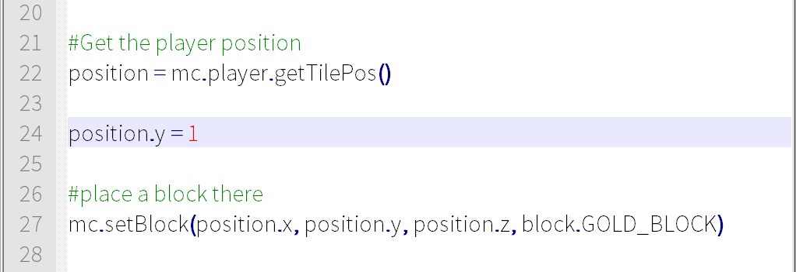
Midas Touch

Slide 28
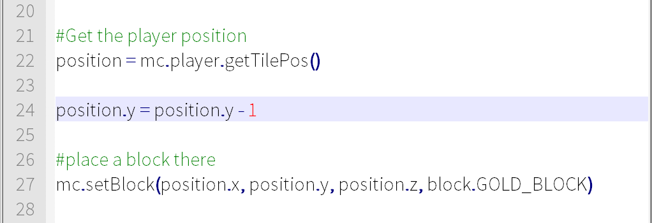
Midas Touch

Slide 29
Midas Touch V2
Keep changing blocks

Slide 30
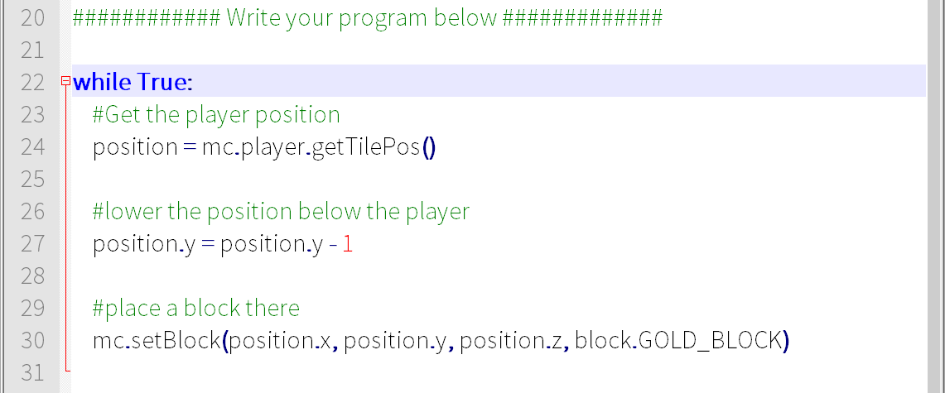
Midas Touch

Slide 31
Midas Touch V3
Don’t change air

Slide 32
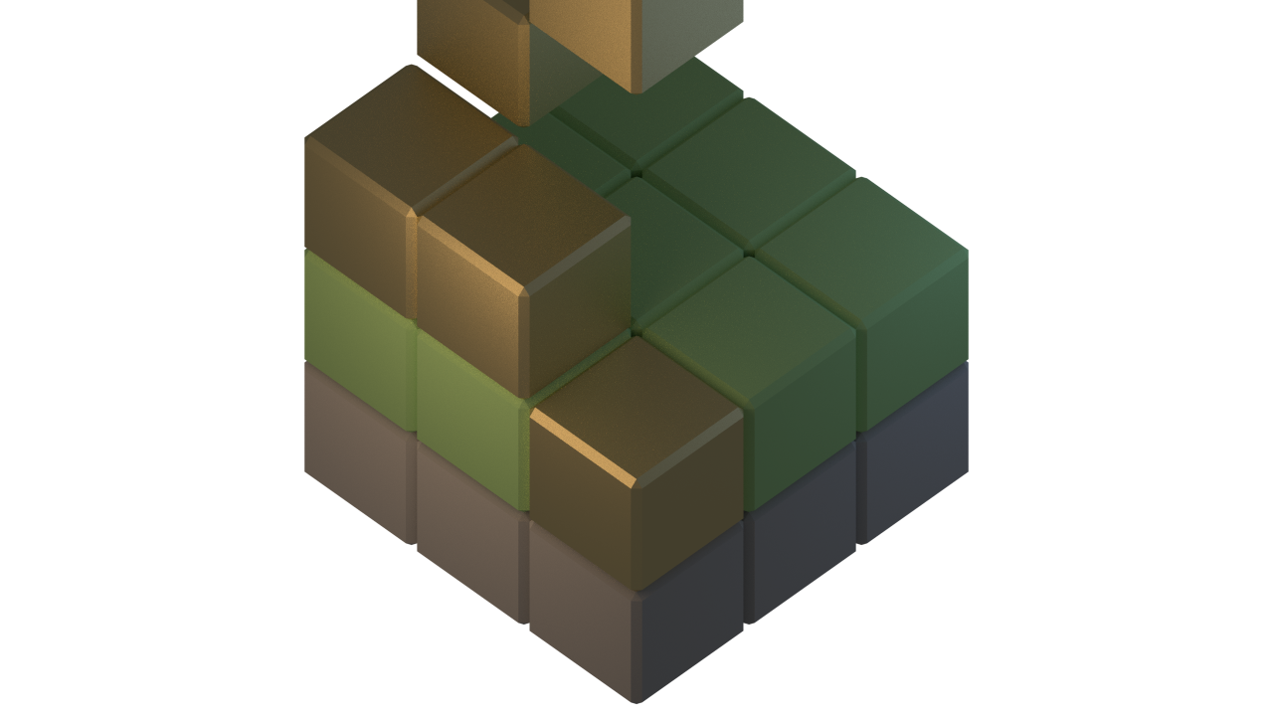

Slide 33
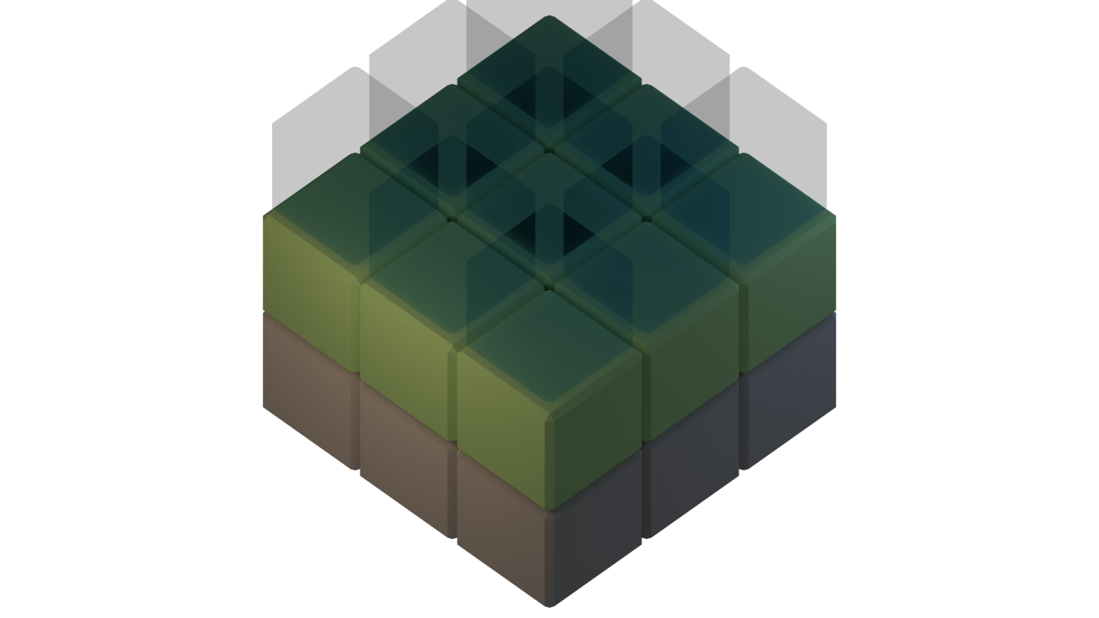

Slide 34
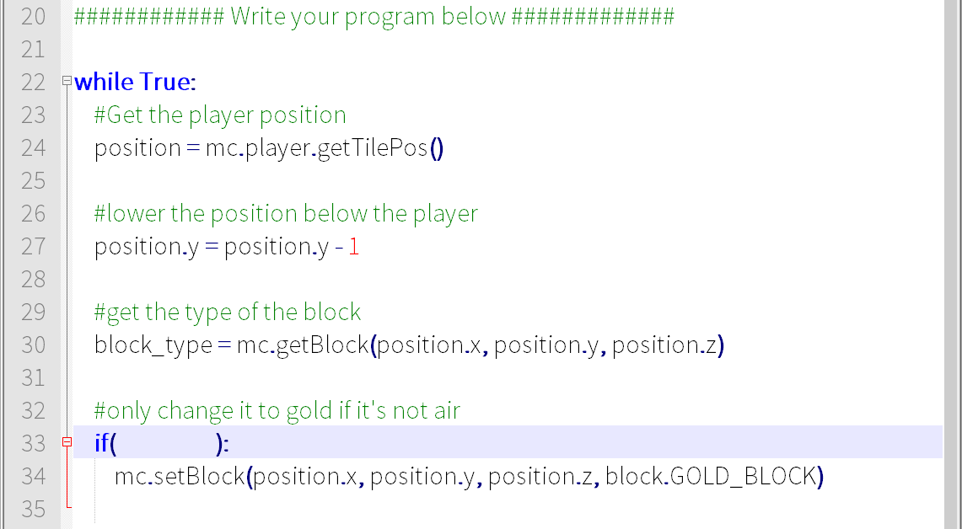
Midas Touch

Slide 35
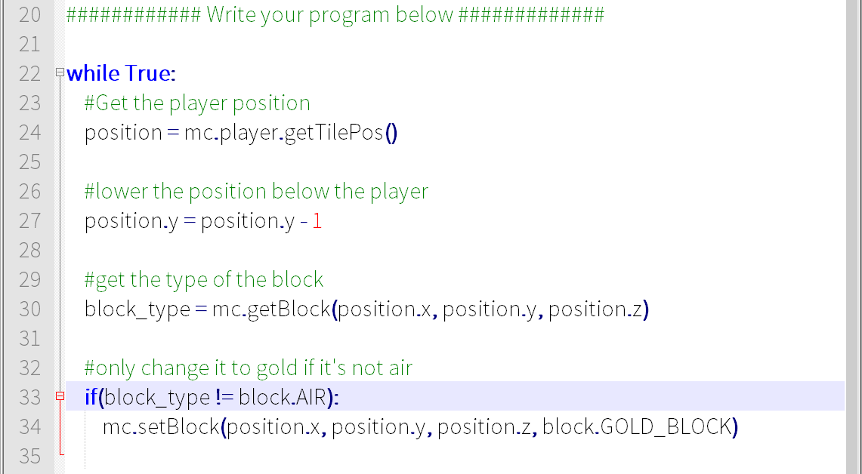
Midas Touch

Slide 36
The sword of exploding TNT
=O

Slide 37
Make a new copy of the template
Open File Browser
Go to Minecraft-Scripts Folder
Copy template.py
Paste in my-scripts and rename (e.g. 2_tnt_sword.py)
Open the file in IDLE

Slide 38
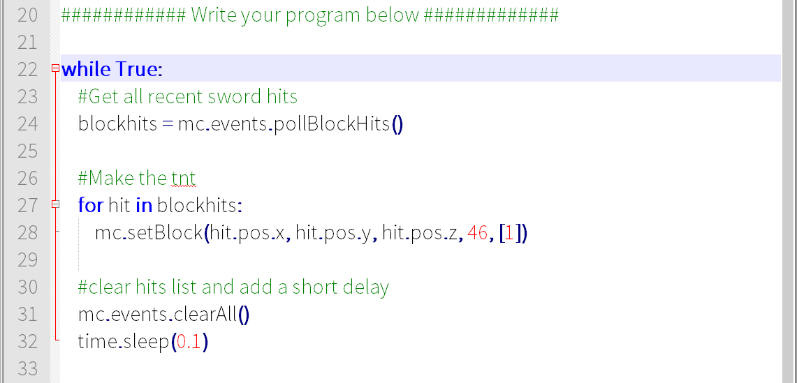
TNT Sword

Slide 39


Challenge: Make a bigger explosion
Try and create more than one block of TNT per hit
Hint: mc.setBlock(hit.pos.x+1, hit.pos.y, hit.pos.z, 46, [1])

